Slide 1
Week-5
Human Resource Management
What is HRM?
-Some major challenges in HRM
-HR concepts- affirmative action and reverse discrimination, contingent worker
-roles of the HRM Manager
-HRM functions
-Recruitment and Selection, sources of employees
-

Slide 2

WHAT IS HRM ?
⑨Human Resource Management (HRM) is an operation/function in companies
Designed to 🖲Maximize employees’ performance
🖲Why?
🖲In order to meet the employer's strategic goals and objectives
🖲How HR can maximize employees’ performance?
🖲HRM focuses on management of people within companies, emphasizing on policies and systems.
🖲What are the processes of managing these people within the
organization?
🖲It is the process of determining HR needs, acquiring
(recruiting&selecting), training(motivating), appraising (rewarding,evalutating), compensating, scheduling employees and Focusing on labor relations, health and safety, fairness concerns
🖲Why?
🖲 So that HR can maintain competent workforce
🖲Why to maintain a competent workforce?
🖲To achieve the goals of an organization in an effective and efficient manner.

Slide 3
SOME MAJOR HR CHALLENGES
▶ Cost (Health care, Training, Hiring process)
▶ Skilled Workers
▶ A shortage of trained workers in important, growth areas (such as IT, Green Technology etc)
▶ Technology (large database)
▶ Overabundance of workers in declining industries, such as steel and automobiles (who need retraining)
▶ Economy (Nation’s Unemployment problem)
▶ Increased outsourcing (jobs going abroad), because labour costs in other countries are much cheaper than in U.S
▶ Changing and Diverse Workforce
▶ Increasing single-parent families, and therefore the need for maternity leave, job sharing, telecommuting etc increases. HR has to balance these needs against organizational profitability
▶ Ethics
▶ A decreased sense of employee loyalty (due to so many firms in the
market, shorter job cycles, contractual work etc.)

Slide 4
Some HR Concepts
Affirmative Action – A Policy that is designed to reduce inequality in hiring by giving neglected groups of society the chance to get selected for jobs. Ex- A quota of hiring a minimum of 5 female workers or members from minority groups (ex-tribal workers) in the coming year
However, this can result in Reverse Discrimination –
Gender Discrimination against males in hiring or promoting
So, HR has to balance affirmative action and reverse discrimination to be fair, ethical and at the same time also ensure performance for the firm
Notes:
Please give your opinion whether to include or not?

Slide 5
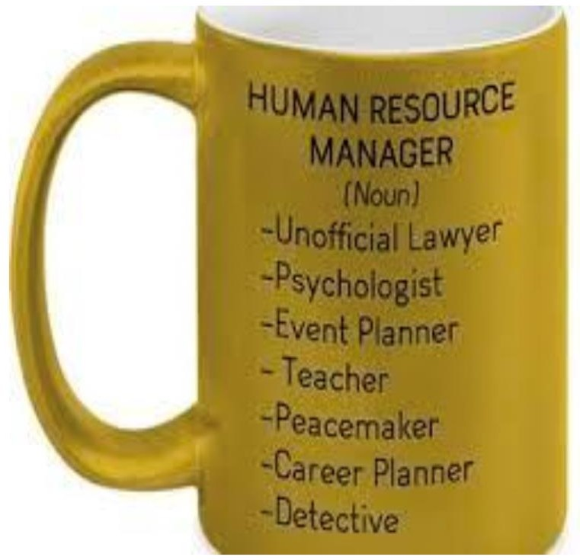
WHAT IS AN HRM MANAGER?
DR. TARNIMA WARDA ANDALIB

Slide 6
ROLES OF AN HRM MANAGER
▶ Developing &Implementing Staffing plan (Recruitment & Selection)
▶ Developing Workplace Policies
▶ Compensating the employees-working as the Benefactor for the
company
▶ Making Retention Policies
▶ Providing Training and Development
▶ Dealing with Laws , Regulations………affecting Employment
▶ Providing Worker Protection
▶ Establishing Communication
▶ Creating Awareness about External Factors

Slide 7





















HRM FUNCTIONS (SPECS-ME-CTR)
Human Resource Managem
Career Manage ment
ent
Recruit ment
Selectio n
Employe
e Union
Relation s
Talent management/
Organizati onal Goals
Equal employment opportunity
Scheduli
ng
Training And
Develop ment
Compen sation and Benefit
Perform ance
Evaluati on
Motivati on
Copyright © 2010 by The McGraw-Hill Companies, Inc. All rights reserved.
Notes:
Adding few more functions from the other discussion to avoid repition

Slide 8
RECRUITMENT AND SELECTION
▶ During Recruitment and selection, the line manager describes the qualifications employees need to fill specific positions.
▶ Then the human resource team (Staff) takes over.
▶ HR managers sort qualified applicants, conduct initial screening interviews, administer the appropriate tests and then refer the best applicants to the line manager, who interviews and selects the ones he or she wants.
▶
Notes:
Suggesting to leave the topic: Badger and Johnson’s model

Slide 9
RECRUITMENT
Recruitment is the set of activities used to obtain a sufficient number of the right employees at the right time.
Recruiting is not an easy task. On the contrary, it become very challenging for several reasons:
  Retaining employees is a challenge
  It is important to hire people who are not only skilled but also fit in with the culture and leadership style of the company
  Sometimes people with necessary skills are not available; then
workers must be hired and trained internally

Slide 10
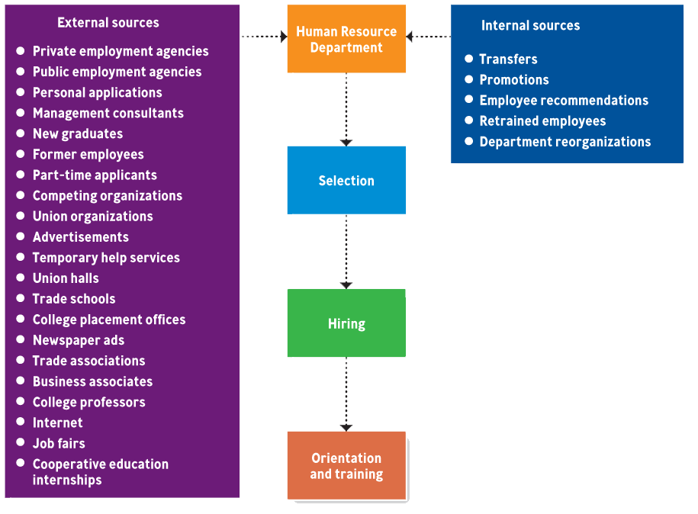
Employee Sources

Slide 11

SELECTION
▶ The process of gathering information and deciding who should be hired, under legal guidelines, to fit the needs of the organization and individuals.
▶ Selection & training are extremely expensive
process.
SELECTION PROCESSES
Step 1.Obtaining complete application forms Step 2.Conducting initial and follow up interviews Step 3. Giving employment tests
Step 4. Conducting background investigations Step 5. Obtaining results from physical exams Step 6. Establishing trial (probationary) periods

Slide 12
HIRING CONTINGENT WORKER
These include part-time workers, temporary workers, seasonal workers, interns, and co-op students.
Also, they are hired on special cases, i.e, to temporarily substitute full-timers, or to meet the peak demand or uncertain economy.
They do not have the expectation of regular,
full-time employment. Contingent workers receive FEW BENEFITS and EARN LESS than permanent workers do.
They are usually highly PRODUCTIVE.

Slide 13


